Slide 1

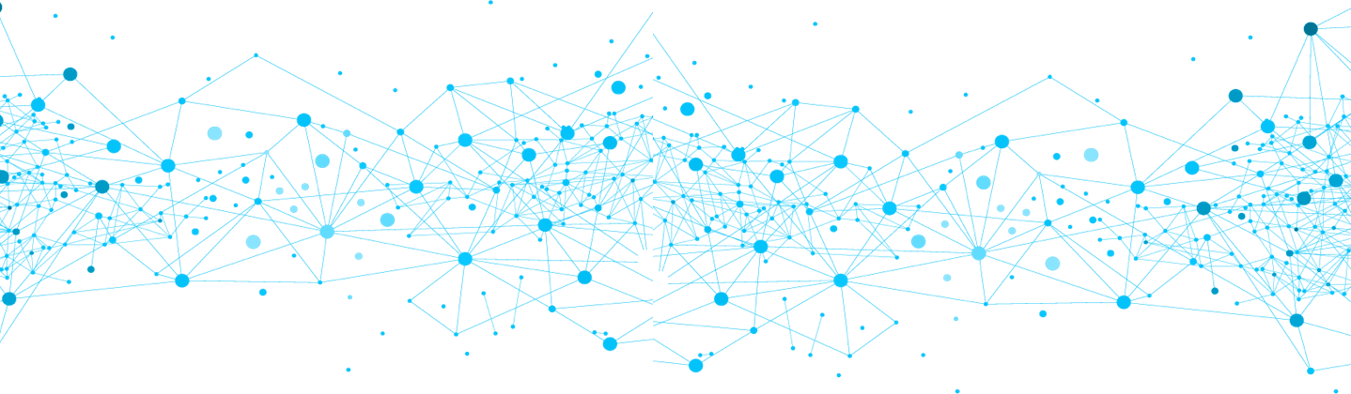
Presentation Deck
SCORE NETWORK
www.scorenetwork.io
Kapil Sharma Rajesh Gupta

Slide 2

Score Network is on a Journey to make DeFi & CeFi more risk averse

Slide 3
Score Network Methodology
Liquidity Risk
Market Risk
Financial Risk
Credit Risk
Stress Testing
Compliance Risk
Risk Platform on in-house risk frameworks
Risk Assessment
Advise on risk mitigation strategies for DeFi/CeFi

Slide 4

Score Network Market Risk Solution (i.e. AAVE & Compound Protocol)
Our ALM tool access interest rate volatility
Risk mitigation strategy based on result
Assets > Liability + Operational Cost

Slide 5

Score Network Liquidity Risk Solution
Customized Stress Testing
Advises on possible source of stress
(Asset)_{t} > (Asset)_{t’}

Slide 6
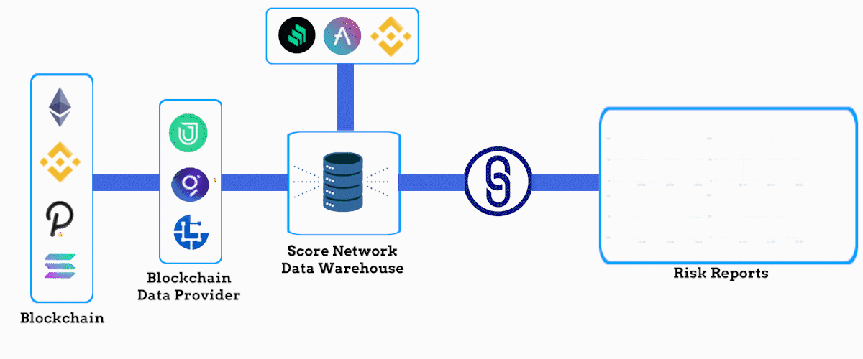
Score Network Risk Platform

Slide 7
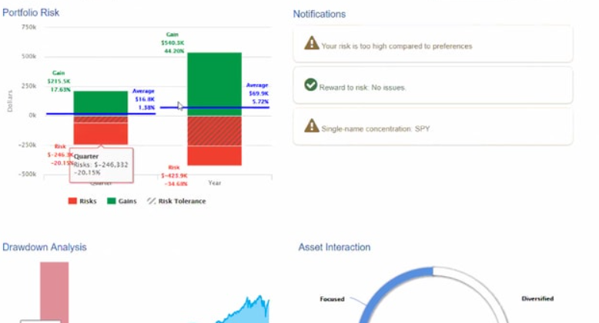

Revenue Generation Model
Risk Platform SCORE NETWORK Risk Consultancy Services
DeFi & CeFi Blockchain Protocol
& CeFi

Slide 8
Roadmap
Q3 2021
Models and Framework Creation
Q4 2021
Service Integration
Q1 2022
Forming Services Network
Q2 2022
Risk Platform Beta Version
Q3
2022
Risk Platform Product Live Release
Risk Platform Alpha Version
Architecture Designing of Risk Platform
Risk Platform Pre-Alpha Phase
Enterprise Sales
Forming Support team
Strategic Partnerships
Testing Models

Slide 9

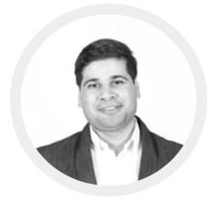




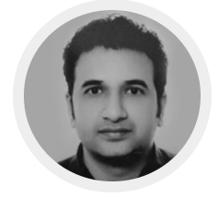

Score Network Team
Rajesh Gupta
Financial Risk Professional
Kapil Sharma
Financial Risk Professional
Irina Jakuvovits
Expert FinTech Professional
Kerle Mikk
Experienced Data Analytics Professional
Sandeep Sharma
Expert Marketing Professional
Ankit Rastogi
Marketing & Sales Professional
Abhishek Sharma
Experienced Marketing Professional
Ashish Rana
Marketing & Branding Consultant

Slide 10
Tokenomics
5% Private Investors
9% Team
5% Strategic Alliance & Advisors
8% Marketing & Branding
Total Supply
10 Billion tokens
50% IDO, ICO and Public Sales
6% Research & Development
13% IT and Risk Platform Development
2% Cyber Security
2% Foundation

Slide 11
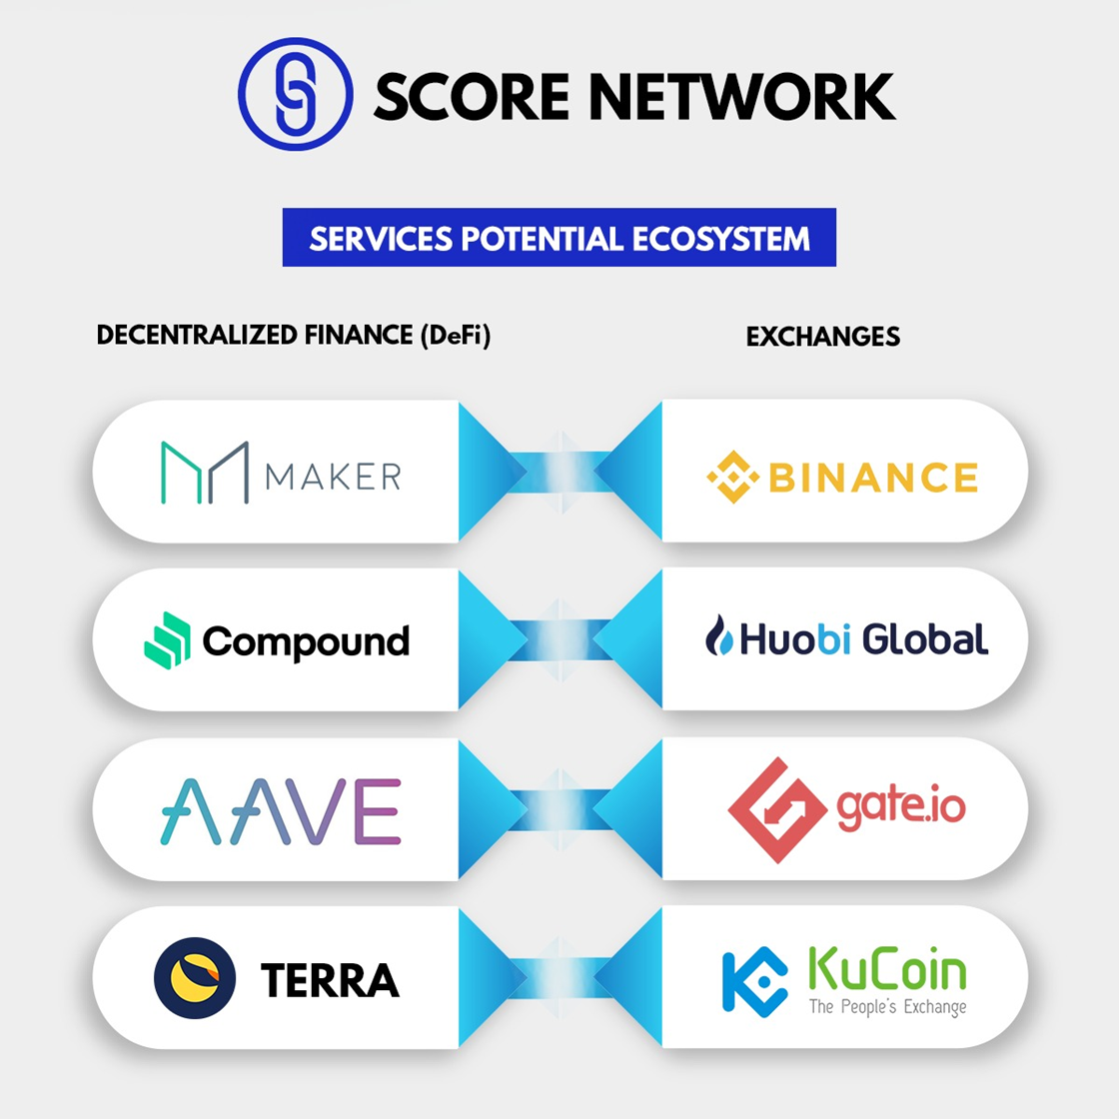
Potential Ecosystem

Slide 12
For questions, feedback and enquiry: info@scorenetwork.io
SCORE NETWORK

